Slide 1
Some Useful MATLAB Functions

Slide 2
Some MATLAB® Math Functions
Function | MATLAB® |  | Function | MATLAB®
cosine | cos or cosd |  | square root | sqrt
sine | sin or sind |  | exponential | exp
tangent | tan or tand |  | logarithm (base 10) | log10
cotangent | cot or cotd |  | natural log (base e) | log
arc cosine | acos or acosd |  | round to nearest integer | round
arc sine | asin or asind |  | round down to integer | floor
arc tangent | atan or atand |  | round up to integer | ceil
arc cotangent | acot or acotd
Note: cos(α) assumes α in radians; whereas, cosd(α) assumes α in degrees.
acos(x) returns the angle in radians; whereas, acosd(x) returns the
angle in degrees.
π radians = 180 degrees

Slide 3
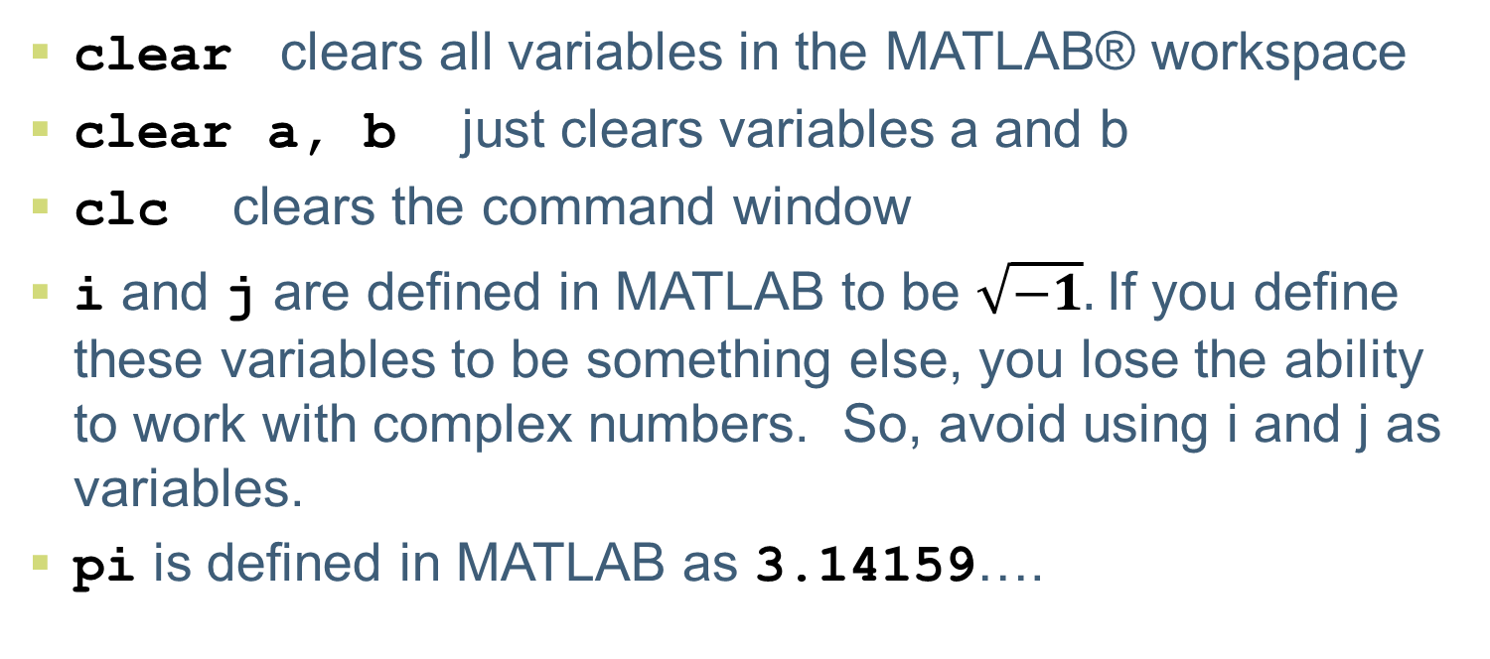
Other Useful Stuff
clear clears all variables in the MATLAB® workspace
clear a, b just clears variables a and b
clc clears the command window
i and j are defined in MATLAB to be $\sqrt{−1}.$If you define these variables to be something else, you lose the ability to work with complex numbers. So, avoid using i and j as variables.
pi is defined in MATLAB as 3.14159….

Slide 4
Help!
The help command provides information about a function. Type help cos at the command prompt. This only works if you know the name of the function you want help with.
You can also click on Help in the MATLAB toolbar and search for information by keyword(s).

